Slide 1


Introduction to Software Business Product management
Emily Crose
For
Oakland university

Slide 2
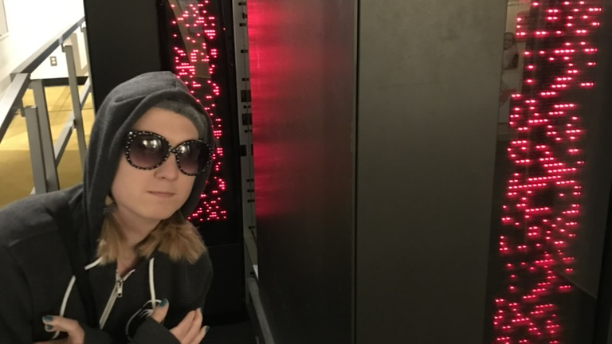
Who am I?
Emily Crose
Information security professional 13 years
Frequent public speaker
Formerly US Intelligence Community
Current research manager @ Sophos

Slide 3

What about you?
Notes:
What about you all? Where do you come from? What kinds of backgrounds do you have?

Slide 4

Course overview
Basic operations of this course
What will we be talking about in this course?
What do you want to learn?

Slide 5
Basic Course Operation
Meet three times/week for 5 weeks
Tuesdays, Wednesdays & Thursdays
7AM Eastern – 10AM Eastern
Moodle
Github
Notes:
We will be meeting 3 times a week on Tuesdays, Wednesdays and Thursdays for the next 5 weeks. We’ll begin around 7AM and end around 10AM Eastern time.
I will make class materials available in two places: Moodle, and Github. Github is one of the tools that we’ll be talking about in this class, so if you want to challenge yourself to put some of what we talk to into practice, jump over to github where the class materials will also be made available.

Slide 6
Material overview
Understanding modern technology fundamentals
How it works
How it is maintained
The Software Development Life Cycle (SDLC)
Tools for managing software development
Management techniques for maintaining codebases
Standards that apply to these topics
Notes:
In this class, we’re going to talk about modern technology. How it works, and how we maintain it. We’ll talk about some of the most popular tools you’ll use in this work. You will also have opportunities to be exposed to these tools in this class through presentations, but also though hands-on use for some of these tools if you choose to do so.
We’re going to talk about the Software Development Life Cycle (Also called the SDLC) and how this general principal applies to developing and maintaining codebases. Alongside that topic, we will talk about some management techniques which can be used to help apply the principals from the SDLC to your everyday work.
Finally, we will talk about some of the standards which apply to these topics, and a few that will apply directly to your work.

Slide 7
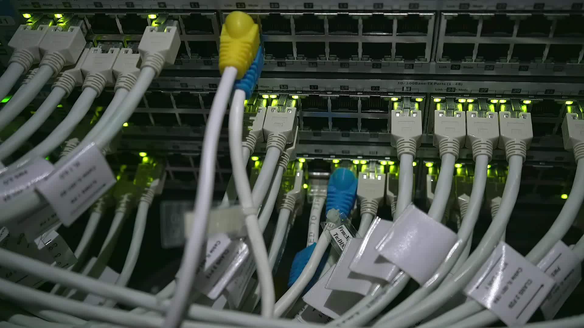
Hardware vs software

Slide 8
Hardware Components
Central Processing Unit (CPU)
Graphics Processing Unit (GPU)
Random Access Memory (RAM)
I/O devices
Keyboard
Mouse
VR Headset

Slide 9
Hardware Components Cont’
Sensors
Temperature
Pressure
gyroscope

Slide 10
Purpose of hardware
The physical half of computing (As opposed to logical)
Does physical calculations
Produces signals which are interpreted by software

Slide 11
Purpose of software
Provides interface between hardware and the user
Software provides a “logical” layer of interpretation

Slide 12
Modern software
Notes:
Modern software operation is a combination of some old things and some new things.

Slide 13
Old things
Old languages
Javascript
C
C++
Assembly
Desktop software
Mainframes?

Slide 14
New things
Mobile & IoT
“THE CLOUD”
AI programming assistance

Slide 15
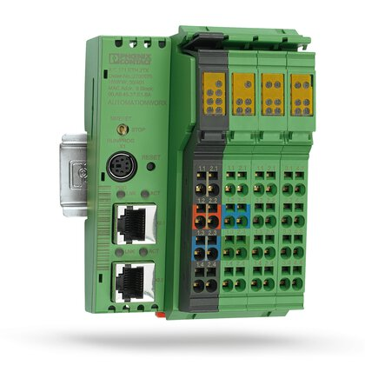
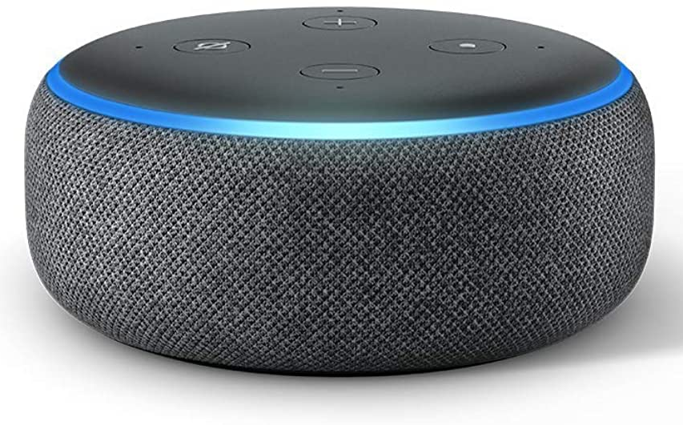
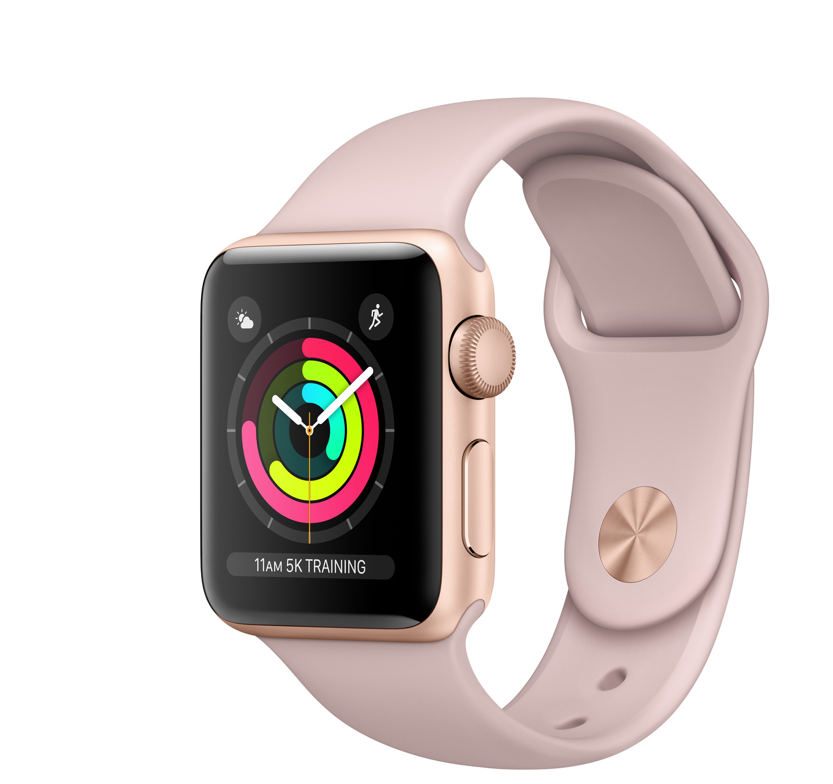
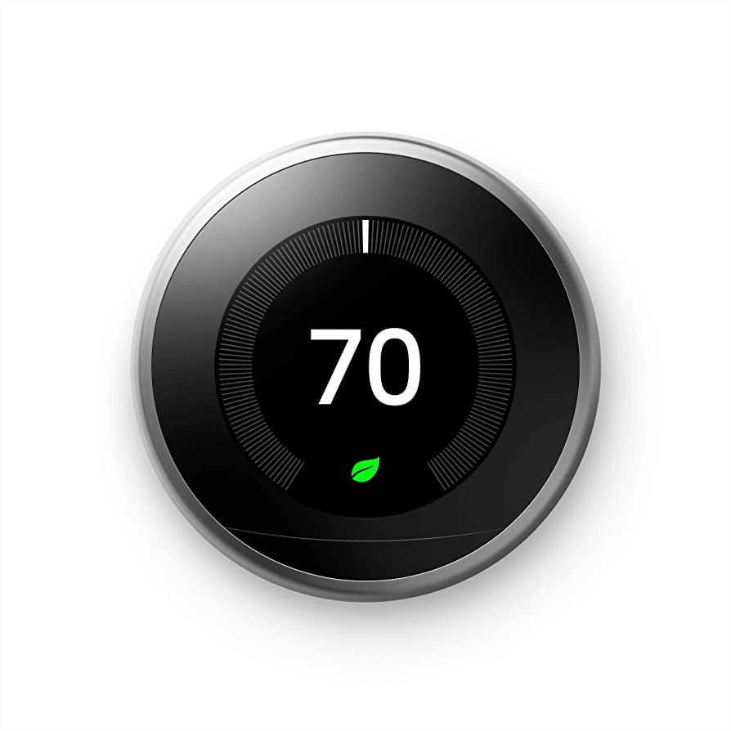
What is mobile/iot?

Slide 16
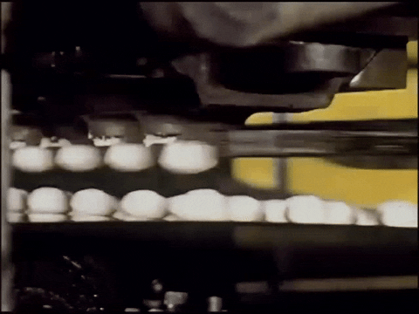
Factory tech
hardware + software!

Slide 17
What is the cloud?
Have we seen this before?

Slide 18
Software snafus
What can go wrong if we don’t get software right?
Program crashes
System stability compromised
Exploitation
Network breach
Theft of IP/customer data
Loss of reputation
Risk of injury?

Slide 19
More & more fails
“Spaghetti” code
Difficult to add new features
Poor documentation/code commenting
“Legacy” code maintenance

Slide 20
Important terminology

Slide 21
Hardware terminology

Slide 22
Software terminology

Slide 23
Questions?

Slide 24
Day 1 review

Slide 25
Day 2 preview
Architecture

